Slide 1
AWS
Architecture
Icons
Release 14-2022.07.31

Slide 2
Release 14-2022.07.31: What’s New?
1/2
For the latest assets package and full resources, visit the AWS Architecture Center: https://aws.amazon.com/architecture/icons/
Guidelines
Building a Diagram for Portrait View (slide 13)
Numbered Callouts (slide 18)
General Resources
Dark background slides have been removed for Groups, Custom Groups, Arrows, and General Icons
Custom Groups instructions are now combined on
one slide (slide 26)
General Icons
Servers / Resource Icon (slide 28)
Source code / Resource Icon (slide 28)
Document / Resource Icon (slide 28)
General Icons cont.
Folder / Resource Icon (slide 28)
Folders / Resource Icon (slide 28)
Globe / Resource Icon (slide 28)
Shield / Resource Icon (slide 28)
Generic application / Resource Icon (slide 28)
Chat / Resource Icon (slide 29)
Alert / Resource Icon (slide 29)
Magnifying glass / Resource Icon (slide 29)
AWS Management Console / Resource Icon (slide 29)
Git repository / Resource Icon (slide 29)
Compute
P4de Instance / Resource Icon (slide 53)
I4i Instance / Resource Icon (slide 54)
End User Computing
Amazon WorkSpaces Web / Previously a Resource Icon (slide 83)
Internet of Things
Fleet Hub / Resource Icon (slide 91)
AWS IoT EduKit (slide 94)
Machine Learning
Amazon CodeWhisperer (slide 106)

Slide 3
Release 14-2022.07.31: What’s New?
2/2
For the latest assets package and full resources, visit the AWS Architecture Center: https://aws.amazon.com/architecture/icons/
Management & Governance
Session Manager / Resource Icon (slide 111)
Change Manager / Resource Icon (slide 111)
Change Calendar / Resource Icon (slide 111)
Compliance / Resource Icon (slide 111)
Quantum Technologies
Embedded simulator / Resource Icon (slide 131)
Managed simulator / Resource Icon (slide 131)
Security, Identity & Compliance
IAM Roles Anywhere / Resource Icon (slide 139)
AWS IAM Identity Center
(successor to AWS Single Sign-On) (slide 141)
Storage
AWS Backup support for Amazon FSx for NetApp ONTAP / Resource Icon (slide 151)

Slide 4
Contents
Introduction
System
Guidelines
Examples
Elements

Slide 5
Introduction
About the deck and guidance for getting started

Slide 6
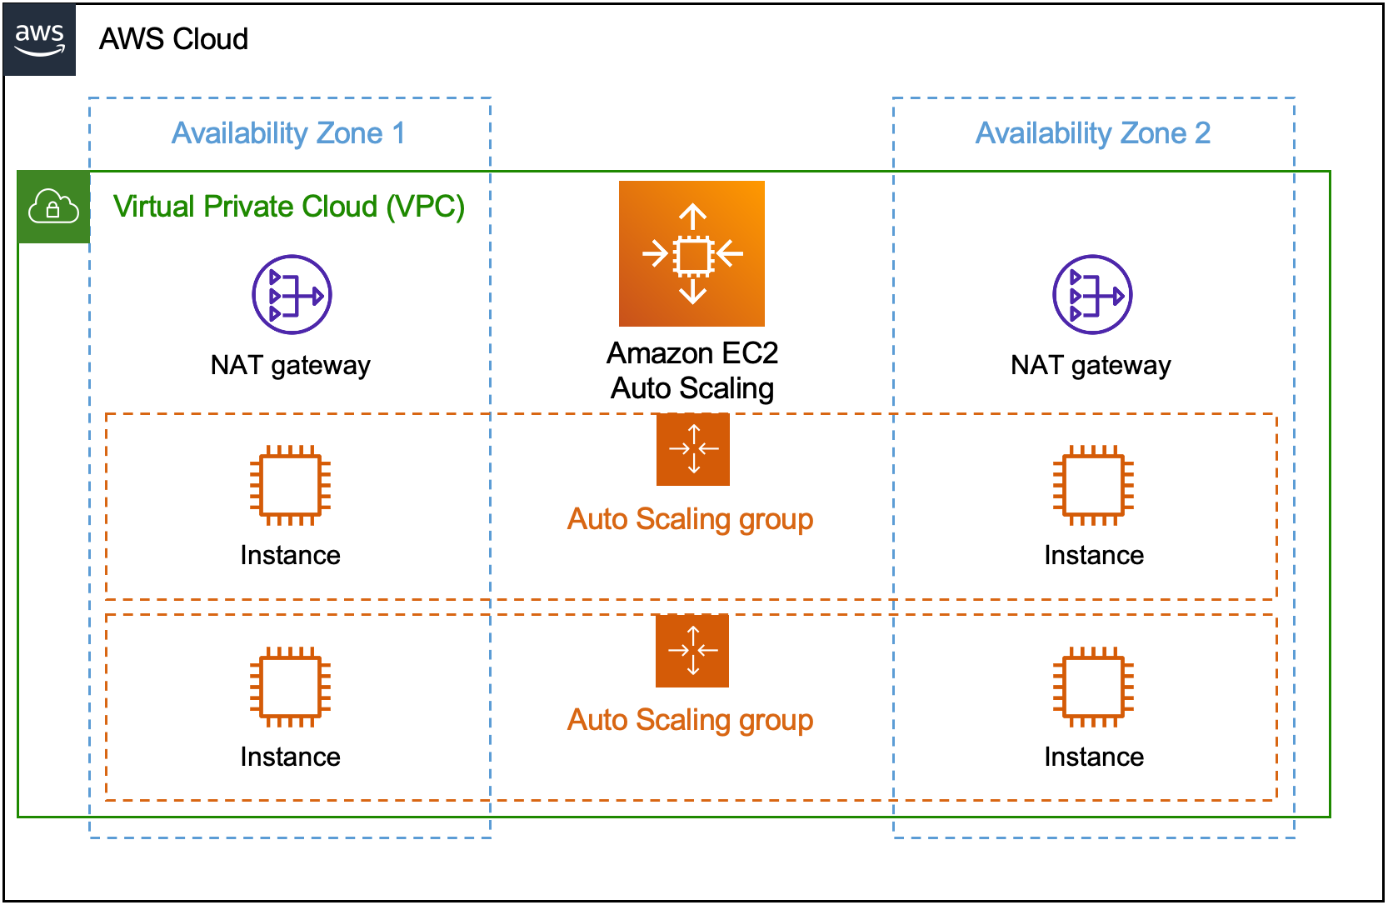
About AWS Architecture Icons
Architecture diagrams are a great way to communicate your design, deployment, and topology.
In this deck, you will find an official collection of AWS service icons, resource icons, additional assets and guidelines. These tools will help you build customer-focused and consistent AWS architecture diagrams.
Customers and partners can use AWS icons to create architecture diagrams. The icons are basic in design so that you can incorporate them directly into your whitepapers, presentations, datasheets, posters, or any technical material that you want.

Slide 7
Before You Begin:
1
Check for the latest
deck update.
Download the latest
deck from the
AWS Architecture Center.
2
Read the guidelines.
For specific element guidance and best practices, see the guidelines.
3
When in doubt,
see the examples.
For completed diagrams, go
to the example pages. If you’re having trouble with a particular layout or object, use these
as a template.

Slide 8
System
A complete overview of the design system

Slide 9




System Elements
AWS Cloud
Groups
Arrows
Service icons
Show the connections between multiple services
or resources
Describe a flow of information or connect different parts
of a diagram
Represent an AWS service
Resource icons
General resource icons
Represent an AWS service resource
Apply to resources and objects for multiple AWS services and categories

Slide 10





System Elements
Group icon
AWS Cloud
Availability Zone 1
Availability Zone 2
Layered groups
Virtual Private Cloud (VPC)
Service icon
NAT gateway
Amazon EC2
Auto Scaling
NAT gateway
Auto Scaling group
Instance
Instance
Auto Scaling group
Resource icon
Instance
Instance

Slide 11
Guidelines
Diagram and element guidance

Slide 12
Building a Diagram
Choose your deck style.
The architecture deck is available for both light and dark backgrounds. Determine which best fits your
need – light backgrounds tend to be used on the web, while dark backgrounds are used for in-person presentations or slide decks.
Start with the structure.
Locate the groups (see slides 25-26) to use for the underlying structure of your diagram.
Add architecture service or resource icons.
If you downloaded the asset package from the AWS Architecture Center, you can search for your icon from your folder. Simply drag & drop or insert wherever you are building your diagram.
Connect the steps.
Use the preset arrows to connect your steps and describe a workflow.
Add any final touches.
You can use numbers to help convey a specific order within your diagram (see slide 18).

Slide 13


Building a Diagram for Portrait View
There are use-cases where a diagram may be added to a Microsoft Word Document, Blog post, etc. that are typically in portrait view. These steps will help you build your diagram in a vertical format so it will fit properly.
Vertical Architectural Diagram
Create a new presentation in PowerPoint.
Architectural diagrams for Microsoft Word documents or other vertical formats may be built in a vertical slide.
Dimension specs.
Go to File > Page Setup then insert new dimensions. Change your slide size to 6.5" width and 8.75" length and keep it on a white background.
Follow the same guidance.
Use the same guidelines and assets from this PowerPoint deck to create your diagram in vertical format.
Paste your diagram as a picture.
Once the diagram is complete, group all the elements and Copy. Then under the Home tab in Word select the Paste dropdown and click Paste as Picture.

Slide 14
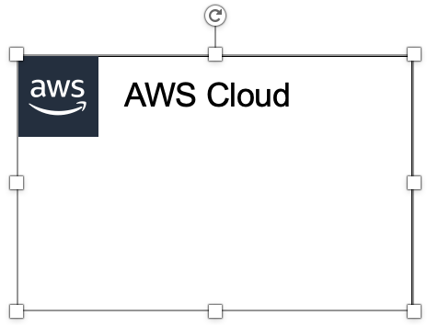

Groups
Each group consists of an icon and a label. Colors and lines help to differentiate groups to make it easier for the user to read a diagram at a glance. Some groups cross multiple groups, such as Auto Scaling, while others are meant to layer inside one another, such as a VPC and subnets.
Resizing groups
Use the bottom-right corner of a group box to resize it.
Layering groups
When you have groups within groups, inner groups should have a .05" buffer on all sides.
DO:
Hold Shift down while resizing an icon to maintain a square.
Use a generic group type if the presets do not suit your needs.
Add a custom group if needed
(see slide 26).
VPC
Public subnet
DON’T:
Create groups with non-approved
AWS icon(s).

Slide 15

Icons
Architecture service icons are designed to be used on both light and dark backgrounds. Please use the appropriate resource icons for the background type. You can find the correct icons in the assets package download or in the PowerPoint presentation. You may rename any of the icons to fit your use case.
Resizing icons
All icons in this deck are SVGs, allowing them to be scaled up or down depending on the diagram. To preserve icon integrity, be sure to hold down Shift while resizing.
DO:
Hold Shift down while resizing.
Change the resource icon text color when using a dark background.
Use the alternate light-bg service icon when appropriate.
DON’T:
Crop service icons.
Flip or rotate icons.
Change icon shapes.

Slide 16

Arrows
Use arrows or lines to connect parts of a diagram or to show a workflow.
Use preset arrows
Copy the preset arrows into your diagram to maintain the correct formatting. To edit, click on the arrow and hold down Shift.
Create new arrows
Preset arrows use the “Open Arrow” in Size 4.
When in doubt, use the default
If the arrow shape that you need is not available in the sample arrows, use the default arrows.
DO:
Use the preset arrow provided in the Elements section.
Use straight lines and right angles to connect objects.
Default Arrow
+ Open Arrow
+ Size 4
DON’T:
Create diagonal lines.
Use anything beside preset or default arrows.
Hold Shift

Slide 17

Icon Labels
The icon and icon label are separated to allow for adjustment or abbreviation. The service icon label should be
12pt Arial and the resource icon label 11pt Arial to show hierarchy. Use the label color defined in this deck for light background diagrams.
Name wrapping and line breaks
AWS service names must fit on no more than two lines. AWS or Amazon should always be accompanied by the service name. Lines should never break mid-word.
Short forms
To save space when using a service multiple times in a diagram, you may use the short service forms instead of the full name. For example, Amazon EC2, instead of Amazon Elastic Compute Cloud.
DO:
Modify color of icon label if necessary.
Break a line after the second word in the service name.
Amazon QuickSight
Amazon
QuickSight
Amazon
Quick-
Sight
DON’T:
Amazon should be on the same line as the first word in the service name.
Use short forms without first mentioning the full service name somewhere in the document.
Duplicate short forms for different services, such as ELB for Elastic Beanstalk and Elastic Load Balancing.
Break a line in the middle of a word.
Lines should never break mid-word, and should fit on two lines max.

Slide 18
Numbered Callouts
Use numbered callouts to draw attention to steps in a process within a diagram. Callouts are black with bold white type so that they stand out among the colored service and resource icons in the diagram. Consult with your team to see if you can use numbered callouts.
Large callouts
For a simple diagram, you can use large callouts (see example on slide 21).
Small callouts
For a complicated diagram, you can use small callouts.
DO:
Use callouts at their predefined size, color
and format.
Order your numbers as linearly as possible, such as left to right, top to bottom, or clockwise.
1
2
3
4
5
6
7
8
9
10
DON’T:
Mix callout sizes within the same diagram.
Change color or font size within the callout.
Use letters or other symbols.
Manually size or stretch the callout shape.
Create new callout shapes.
1
2
3
4
5
6
7
8
9
10

Slide 19
Examples
The system in action

Slide 20



Example: Git to S3 Webhooks
AWS Cloud
Amazon S3
SSH key bucket
Git push
Third-party Git repository
Git webhook
Git users
AWS KMS key
AWS Lambda
AWS Lambda
Amazon S3 output bucket

Slide 21

Example: Chef Automate Architecture on AWS
AWS Cloud
Availability Zone
Chef Knife uploads cookbooks.
Knife bootstraps and communicates with nodes.
Chef client processes run list.
VPC
Internet gateway
Public subnet
1
Chef Automate
3
Chef workstation
(local Chef repo)
2
Chef node
10.0.0.0/19
10.0.0.0/16
This example uses large numbered callouts

Slide 22
Elements
Resources to use when building your diagram

Slide 23
Icon Categories
Click a category to jump to slide (must be in Presentation mode)
General Resources
Analytics
Application Integration
Blockchain
Business Applications
Cloud Financial Management
Compute
Contact Center
Containers
Customer Enablement
Database
Developer Tools
End User Computing
Front-End Web & Mobile
Game Tech
Internet of Things
Machine Learning
Management & Governance
Media Services
Migration & Transfer
Networking & Content Delivery
Quantum Technologies
Robotics
Satellite
Security, Identity, & Compliance
Serverless
Storage
VR & AR

Slide 24
General Resources

Slide 25












Groups
1/5
*
AWS Cloud
AWS Cloud
Region
Availability Zone
Security group
Auto Scaling group
VPC
Private subnet
Public subnet
Server contents
Corporate
data center
EC2 instance contents
Spot Fleet
AWS account
AWS IoT Greengrass Deployment
AWS IoT Greengrass
Elastic Beanstalk container
AWS Step Functions workflow
Generic group
Generic group
*
In certain regions (i.e. China), AWS does not own the rights for the logo using the letters “AWS.” Per our guidelines, use the group with the AWS logo except in regions where the AWS logo cannot be used. You may use the group with the cloud icon in those cases.

Slide 26




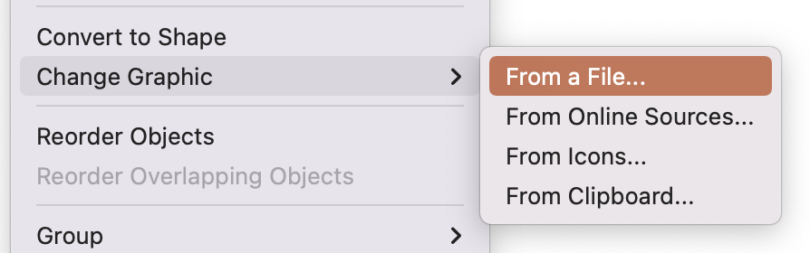
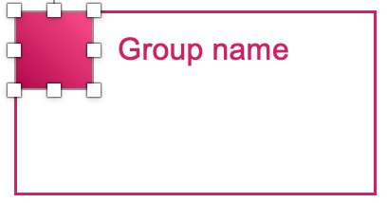



Create a Custom Group for a Service
2/5
Select a group with the category color where you find your service to start creating your custom group. All groups are fully editable.
Edit group name
Edit group name
Edit group name
Edit group name
Download the asset package.
Go to the AWS Architecture Icons webpage and download the asset package to your desktop.
Begin customizing.
In your chosen group, select the square icon and choose Change Graphic > From a File.
Find the service icon.
Navigate to the architecture service icon DELIVERABLES folder in the asset package.
Then find the appropriate category folder where
the service appears.
Insert the service icon.
In the Arch_32 folder, select the architecture service icon SVG file, then click Insert. Do not choose a PNG file, image quality will be degraded.
Analytics
Game Tech
Networking & Content Delivery
Serverless
Application Integration
Management & Governance
VR & AR
Cloud Financial Management
Internet of Things
Storage
End User Computing
Machine Learning
Migration & Transfer
Edit group name
Edit group name
Edit group name
Blockchain
Compute
Containers
Media Services
Quantum Technologies
Business Applications
Contact Center
Front-End Web & Mobile
Robotics
Security, Identity & Compliance
Customer Enablement
Database
Developer Tools
Satellite

Slide 27
Arrows
3/5

Slide 28






























General Icons
4/5
AWS Marketplace
Client
Disk
Forums
Generic database
Internet
Internet alt1
Internet alt2
Mobile client
Firewall
Email
Multimedia
Office building
SAML token
SSL padlock
Tape storage
User
Users
Toolkit
SDK
Gear
Traditional server
Servers
Source code
Document
Documents
Folder
Folders
Globe
Shield
Generic application

Slide 29







General Icons
5/5
AWS Marketplace
Chat
Camera
Alert
Magnifying Glass
AWS Management Console
Git repository
Question

Slide 30

Analytics
STANDARD
CATEGORY ICON

Slide 31







Analytics
1/5
Amazon CloudSearch
Amazon EMR
Amazon Kinesis
Search documents
Cluster
HDFS
cluster
EMR engine

Slide 32




Analytics
2/5
Amazon Kinesis
Video Streams
Amazon Kinesis
Data Streams
Amazon Kinesis
Data Firehose
Amazon Kinesis
Data Analytics

Slide 33






Analytics
3/5
AWS Glue
AWS Glue
Elastic Views
Amazon Athena
Amazon OpenSearch Service
Crawler
AWS Glue
Data Catalog

Slide 34




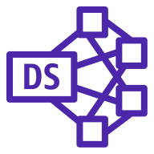

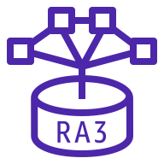

Analytics
4/5
Amazon Redshift
Amazon QuickSight
AWS Lake Formation
AWS Data Pipeline
Dense
compute node
Dense
storage node
Data lake
RA3
Redshift ML

Slide 35






Analytics
5/5
Amazon Managed Streaming for Apache Kafka
AWS Data Exchange
AWS Glue DataBrew
Amazon FinSpace
Amazon MSK Connect
AWS Data Exchange for APIs

Slide 36

Application
Integration
STANDARD
CATEGORY ICON

Slide 37



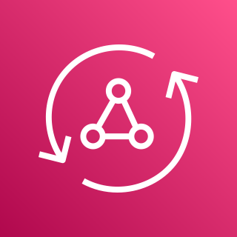






Application Integration
1/3
Amazon Simple Notification Service (Amazon SNS)
Amazon Simple Queue Service (Amazon SQS)
Amazon MQ
AWS AppSync
Email notification
Message
Broker
HTTP notification
Queue
Topic

Slide 38











Application Integration
2/3
AWS Step Functions
Amazon EventBridge
AWS Console
Mobile Application
AWS Express
Workflows
Event
Rule
Default
event bus
Custom
event bus
SaaS
event bus
Schema registry
Schema

Slide 39




Application Integration
3/3
Amazon AppFlow
Amazon Managed Workflows for Apache Airflow
Amazon API Gateway
Endpoint

Slide 40

Blockchain
STANDARD
CATEGORY ICON

Slide 41



Blockchain
1/1
Amazon Managed
Blockchain
Amazon Quantum Ledger Database (Amazon QLDB)
Blockchain

Slide 42

Business
Applications
STANDARD
CATEGORY ICON

Slide 43




Business Applications
1/3
Alexa for Business
Amazon Chime
Amazon WorkMail
Amazon Honeycode

Slide 44






Business Applications
2/3
Amazon Connect
Amazon Pinpoint
Amazon Simple Email
Service (Amazon SES)
Amazon WorkDocs
Journey
Email

Slide 45

Business Applications
3/3
Amazon Chime SDK
Amazon Chime Voice Connector
Amazon Pinpoint APIs
Amazon WorkDocs SDK

Slide 46

Cloud Financial Management
STANDARD
CATEGORY ICON

Slide 47




Cloud Financial Management
1/2
AWS Budgets
AWS Cost &
Usage Report
AWS Cost Explorer
Reserved Instance (RI) Reporting

Slide 48



Cloud Financial Management
2/2
Savings Plans
AWS Application Cost Profiler
AWS Billing Conductor

Slide 49

Compute
STANDARD
CATEGORY ICON

Slide 50





























Compute
1/12
Resource Icons
Amazon Elastic Compute Cloud (Amazon EC2)
AMI
Auto scaling
Elastic IP address
Rescue
AWS Microservice Extractor for .NET
Instance
Instances
Spot Instance
Instance with CloudWatch
Habana Gaudi instance
Trainium instance
General-purpose
instances
Mac instance
M1 Mac instance
T4g instance
T3 instance
T3a instance
T2 instance
M6g instance
M6gd instance
M6i instance
M6a instance
M5 instance
M5a instance
M5d instance
M5n instance
M5dn instance
M5zn instance
M4 instance
A1 instance

Slide 51













Compute
2/12
Amazon Elastic Compute Cloud (Amazon EC2)
Compute-optimized
instances
C7g instance
C6g instance
C6gd instance
C6gn instance
C6i instance
C6a instance
Hpc6a instance
C5 instance
C5d instance
C5a instance
C5ad instance
C5n instance
C4 instance

Slide 52












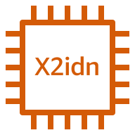


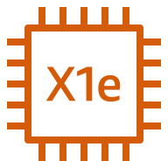
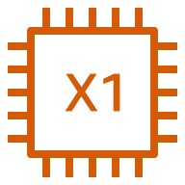

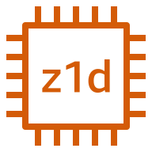
Compute
3/12
Amazon Elastic Compute Cloud (Amazon EC2)
Memory-optimized
instances
R6g instance
R6i instance
R5 instance
R5a instance
R5d instance
R5ad instance
R5gd instance
R5b instance
R5n instance
Rdn instance
R4 instance
X2gd instance
X2idn instance
X2iedn instance
X2iezn instance
X1e instance
X1 instance
High Memory instance
z1d instance

Slide 53

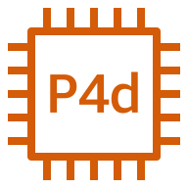














Compute
4/12
Amazon Elastic Compute Cloud (Amazon EC2)
Accelerated-computing
instances
P4 instance
P4d instance
P4de instance
P3 instance
P3dn instance
P2 instance
DL1 instance
Trn1 instance
Inf1 instance
G5 instance
G5g instance
G4dn instance
G4ad instance
G3 instance
F1 instance
VT1 instance

Slide 54











Compute
5/12
Amazon Elastic Compute Cloud (Amazon EC2)
Storage-optimized
instances
Im4gn instance
Is4gen instance
I4i instance
I3 instance
I3en instance
I2 instance
D2 instance
D3 instance
D3en instance
H1 instance
DB instance

Slide 55






Compute
6/12
AWS Elastic Beanstalk
AWS Lambda
Amazon Lightsail
Amazon EC2
Auto Scaling
Deployment
Lambda function
Application

Slide 56




Compute
7/12
AWS Outposts family
AWS Outposts rack
AWS Outposts servers
AWS Serverless
Application Repository

Slide 57




Compute
8/12
VMware Cloud on AWS
AWS Thinkbox Deadline
AWS Thinkbox XMesh
AWS Thinkbox Frost

Slide 58




Compute
9/12
AWS Thinkbox Krakatoa
AWS Thinkbox Sequoia
AWS Thinkbox Stoke
AWS Wavelength

Slide 59




Compute
10/12
AWS Compute Optimizer
AWS Local Zones
Amazon EC2 Image Builder
Bottlerocket

Slide 60




Compute
11/12
AWS ParallelCluster
NICE DCV
Elastic Fabric Adapter
AWS Nitro Enclaves

Slide 61




Compute
12/12
AWS App Runner
NICE EnginFrame
Amazon Genomics CLI
AWS Batch

Slide 62

Contact Center
CATEGORY ICON
COMING SOON

Slide 63
Contact Center
1/1
Amazon Connect

Slide 64

Containers
STANDARD
CATEGORY ICON

Slide 65












Containers
1/3
Amazon Elastic Kubernetes Service (Amazon EKS)
Amazon Elastic Container Registry (Amazon ECR)
Amazon Elastic Container Service (Amazon ECS)
Amazon ECS Anywhere
Registry
Container 1
Container 2
Image
Container 3
Service
Task
Copilot CLI

Slide 66




Containers
2/3
Amazon EKS Anywhere
Amazon EKS Cloud
Amazon EKS Distro
AWS Fargate

Slide 67

Containers
3/3
Red Hat OpenShift

Slide 68

Customer Enablement
STANDARD
CATEGORY ICON

Slide 69




Customer Enablement
1/2
AWS IQ
AWS Managed
Services
AWS Professional
Services
AWS Support

Slide 70



Customer Enablement
2/2
AWS Training and Certification
AWS Activate
AWS re:Post

Slide 71

Database
STANDARD
CATEGORY ICON

Slide 72

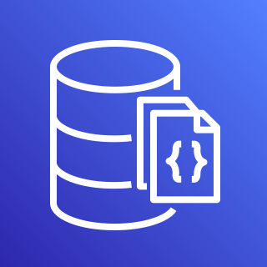







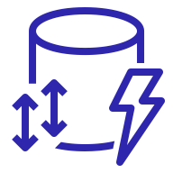


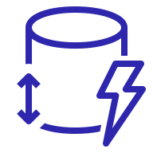
Database
1/5
Amazon Aurora
Amazon DocumentDB
(with MongoDB compatibility)
Amazon DynamoDB
Attribute
Items
Amazon DynamoDB Accelerator (DAX)
Stream
Item
Table
Standard Access table class
Attributes
Global secondary
index
Standard–Infrequent Access table class

Slide 73





Database
2/5
Amazon Keyspaces
(for Apache Cassandra)
AWS Database Migration Service (AWS DMS)
Amazon Neptune
Amazon Quantum Ledger Database (Amazon QLDB)
Database migration
workflow or job

Slide 74









Database
3/5
Amazon Relational Database Service (Amazon RDS)
Amazon RDS on
VMware
Amazon Timestream
Amazon ElastiCache
Multi-AZ
Cache node
ElastiCache
for Redis
Multi-AZ DB cluster
ElastiCache for Memcached

Slide 75

Database
4/5
Amazon MemoryDB for Redis

Slide 76











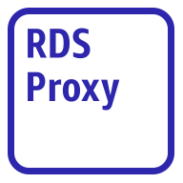
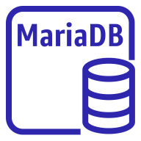



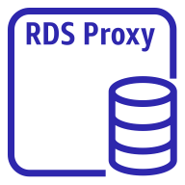
Database
5/5
Amazon Aurora instance
Amazon Aurora instance alternate
Amazon RDS instance
Amazon RDS
instance alternate
MySQL
instance
MySQL
instance alternate
Oracle
instance
Oracle
instance alternate
PostgreSQL
instance
PostgreSQL
instance alternate
PIOPS
instance
Amazon RDS
proxy instance alternate
MariaDB instance
MariaDB instance alternate
SQL Server
instance
SQL Server
instance alternate
Amazon RDS
proxy instance

Slide 77

Developer
Tools
STANDARD
CATEGORY ICON

Slide 78





Developer Tools
1/4
AWS Cloud9
AWS CodeBuild
AWS CodeCommit
AWS CodeDeploy
Cloud9

Slide 79




Developer Tools
2/4
AWS CodePipeline
AWS CodeStar
AWS Command Line
Interface (AWS CLI)
AWS Tools
and SDKs

Slide 80

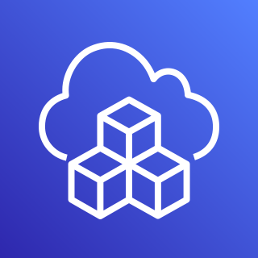


Developer Tools
3/4
AWS X-Ray
AWS Cloud Development Kit (AWS CDK)
AWS CodeArtifact
AWS CloudShell

Slide 81


Developer Tools
4/4
Amazon Corretto
AWS Cloud Control API

Slide 82

End User
Computing
STANDARD
CATEGORY ICON

Slide 83

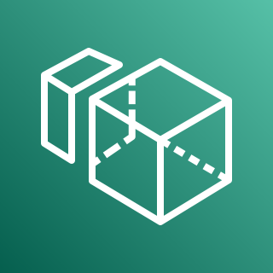


End User Computing
1/1
Amazon AppStream 2.0
Amazon WorkSpaces
Amazon WorkSpaces Web
Amazon WorkLink

Slide 84

Front-End Web
& Mobile
STANDARD
CATEGORY ICON

Slide 85









Front-End Web & Mobile
1/1
AWS Amplify
AWS Device Farm
Amazon Location Service
AWS Amplify Studio
Track
Place
Map
Geofence
Routes

Slide 86

Game Tech
STANDARD
CATEGORY ICON

Slide 87




Game Tech
1/2
Amazon GameLift
AWS GameKit
Amazon GameSparks
Open 3D Engine

Slide 88

Game Tech
2/2
Amazon Lumberyard

Slide 89

Internet of
Things
STANDARD
CATEGORY ICON

Slide 90









Internet of Things
1/7
FreeRTOS
AWS IoT 1-Click
AWS IoT Analytics
AWS IoT Button
Channel
Dataset
Pipeline
Notebook
Data store

Slide 91






Internet of Things
2/7
AWS IoT Core
AWS IoT Device
Defender
AWS IoT Device
Management
AWS IoT Events
IoT device jobs
Fleet Hub

Slide 92



















Internet of Things
3/7
AWS IoT Greengrass
AWS IoT SiteWise
AWS IoT Things Graph
Connector
Stream manager
Artifact
Component
Asset model
Asset
Component machine learning
Component nucleus
Component private
Component public
Properties
Data streams
Interprocess communication
Protocol
Recipe
Asset hierarchy

Slide 93




Internet of Things
4/7
AWS IoT ExpressLink
AWS IoT TwinMaker
AWS IoT RoboRunner
AWS IoT FleetWise

Slide 94

Internet of Things
5/7
AWS IoT EduKit

Slide 95



























Internet of Things
6/7
IoT action
IoT actuator
IoT certificate
IoT desired state
IoT hardware board
IoT HTTP protocol
IoT HTTP/2 protocol
IoT MQTT protocol
IoT policy
IoT reported state
IoT rule
IoT sensor
IoT servo
IoT shadow
IoT simulator
IoT topic
Alexa skill
Alexa Voice Service
Alexa-enabled device
Echo
Fire TV
Fire TV Stick
Lambda function
Over-the-air update
Device gateway
AWS IoT Core for LoRaWAN protocol
LoRaWAN protocol

Slide 96


























Internet of Things
7/7
IoT thing bank
IoT thing bicycle
IoT thing camera
IoT thing car
IoT thing cart
IoT thing coffee pot
IoT thing door lock
IoT thing factory
IoT thing generic
IoT thing house
IoT thing lightbulb
IoT thing travel
IoT thing medical emergency
IoT thing police emergency
IoT thing utility
IoT thing windfarm
IoT thing humidity sensor
IoT thing vibration sensor
IoT thing temperature sensor
IoT thing temperature & humidity sensor
IoT thing temperature & vibration sensor
IoT thing relay
IoT thing stack light
IoT thing FreeRTOS device
IoT thing industrial PC
IoT thing PLC

Slide 97

Machine
Learning
STANDARD
CATEGORY ICON

Slide 98




Machine Learning
1/9
Amazon Comprehend
Amazon Elastic
Inference
Amazon Forecast
Amazon Lex

Slide 99










Machine Learning
2/9
Amazon Personalize
Amazon Polly
Amazon Rekognition
Amazon SageMaker
Amazon Rekognition
image
Notebook
Canvas
Amazon Rekognition
video
Model
Train

Slide 100




Machine Learning
3/9
Amazon SageMaker
Ground Truth
Amazon Textract
Amazon Transcribe
Amazon Translate

Slide 101




Machine Learning
4/9
AWS Deep
Learning AMIs
AWS Deep Learning Containers
AWS DeepLens
AWS DeepRacer

Slide 102



Machine Learning
5/9
Apache MXNet on AWS
TensorFlow on AWS
AWS DeepComposer
Amazon Augmented AI (Amazon A2I)

Slide 103




Machine Learning
6/9
Amazon Fraud Detector
Amazon Kendra
Amazon CodeGuru
TorchServe

Slide 104




Machine Learning
7/9
Amazon Lookout
for Equipment
Amazon Lookout
for Metrics
Amazon Lookout
for Vision
Amazon Monitron

Slide 105





Machine Learning
8/9
Amazon DevOps Guru
Amazon HealthLake
AWS Panorama
AWS Neuron
Insights

Slide 106



Machine Learning
9/9
Amazon SageMaker
Studio Lab
Amazon Comprehend
Medical
Amazon CodeWhisperer

Slide 107

Management & Governance
STANDARD
CATEGORY ICON

Slide 108















Management & Governance
1/8
Amazon CloudWatch
AWS Auto Scaling
AWS CloudFormation
Alarm
Rule
RUM
Change set
Stack
Event
(time-based)
Event
(event-based)
Evidently
Template
Logs
Synthetics
Metrics Insights

Slide 109






Management & Governance
2/8
AWS Application
Auto Scaling
AWS Config
AWS License Manager
AWS Personal
Health Dashboard
License blending
Application discovery

Slide 110











Management & Governance
3/8
AWS Management
Console
AWS OpsWorks
AWS CloudTrail
Apps
Instances
Monitoring
Permissions
Deployments
Layers
Resources
Stack2

Slide 111















Management & Governance
4/8
AWS Service Catalog
AWS Systems Manager
Automation
Documents
Patch Manager
Parameter Store
OpsCenter
Inventory
Maintenance Windows
State Manager
Run Command
Session Manager
Change Manager
Change Calendar
Compliance

Slide 112








Management & Governance
5/8
AWS Trusted Advisor
AWS Well-Architected Tool
AWS Control Tower
Checklist
cost
Checklist
performance
Checklist
security
Checklist
fault tolerant
Checklist

Slide 113
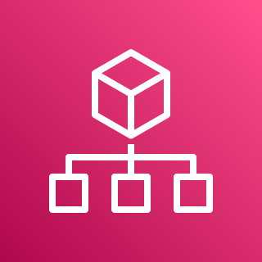






Management & Governance
6/8
AWS Organizations
AWS AppConfig
AWS Chatbot
AWS Backint Agent
Account
Organizational unit
Management account

Slide 114




Management & Governance
7/8
AWS Fault Injection
Simulator
Amazon Managed Grafana
Amazon Managed Service
for Prometheus
AWS Distro for OpenTelemetry

Slide 115




Management & Governance
8/8
AWS Proton
AWS Launch Wizard
AWS Systems Manager Incident Manager
AWS Resilience Hub

Slide 116

Media Services
STANDARD
CATEGORY ICON

Slide 117





Media Services
1/4
Amazon Elastic
Transcoder
Amazon Kinesis
Video Streams
AWS Elemental
MediaConnect
AWS Elemental MediaConvert
AWS Cloud Digital Interface

Slide 118




Media Services
2/4
AWS Elemental
MediaLive
AWS Elemental
MediaPackage
AWS Elemental
MediaStore
AWS Elemental
MediaTailor

Slide 119

Media Services
3/4
AWS Elemental
Conductor
AWS Elemental Delta
AWS Elemental Live
AWS Elemental
Server

Slide 120



Media Services
4/4
AWS Elemental
Appliances & Software
Amazon Interactive
Video Service
AWS Elemental Link
Amazon Nimble Studio

Slide 121

Migration &
Transfer
STANDARD
CATEGORY ICON

Slide 122











Migration & Transfer
1/2
AWS Application
Discovery Service
AWS Transfer Family
AWS DataSync
AWS Migration Hub
AWS FTPS
Agent
Refactor Spaces services
AWS SFTP
Refactor Spaces applications
AWS FTP
Refactor Spaces environments

Slide 123









Migration & Transfer
2/2
AWS Server Migration
Service (AWS SMS)
AWS Application
Migration Service
AWS Migration Evaluator
AWS Mainframe Modernization
Analyzer
Compiler
Converter
Runtime
Developer

Slide 124
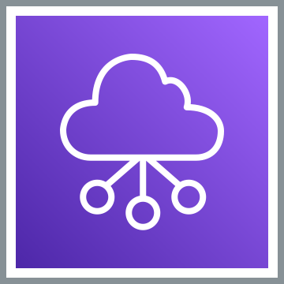
Networking &
Content Delivery
STANDARD
CATEGORY ICON

Slide 125







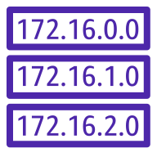








Networking & Content Delivery
1/5
AWS Transit Gateway
Amazon CloudFront
Amazon Route 53
Attachment
Download distribution
Edge location
Hosted zone
Route table
Readiness checks
Streaming distribution
Functions
Resolver
Resolver DNS firewall
Routing controls
Resolver query logging
Application recovery controller

Slide 126















Networking & Content Delivery
2/5
Amazon Virtual Private Cloud (Amazon VPC)
Customer gateway
Internet gateway
VPN gateway
Flow logs
Endpoints
Router
Traffic mirroring
NAT gateway
Elastic network interface
Elastic network
adapter
Network access
control list
VPN connection
Peering connection
Reachability analyzer
Carrier gateway
Network access analyzer

Slide 127













Networking & Content Delivery
3/5
AWS App Mesh
AWS Cloud Map
AWS Direct Connect
AWS Global Accelerator
Mesh
Virtual
gateway
Service
Gateway
Virtual node
Virtual router
Namespace
Virtual service
Resource

Slide 128








Networking & Content Delivery
4/5
AWS Client VPN
AWS Site-to-Site VPN
Elastic Load Balancing
AWS PrivateLink
Application Load
Balancer
Network Load
Balancer
Classic Load
Balancer
Gateway Load
Balancer

Slide 129




Networking & Content Delivery
5/5
AWS Cloud WAN
AWS Private 5G
Segment network
Core network edge

Slide 130

Quantum Technologies
STANDARD
CATEGORY ICON

Slide 131














Quantum Technologies
1/1
Amazon Braket
Chandelier
Chip
QPU
Simulator
Simulator 1
Simulator 2
Simulator 3
Simulator 4
State vector
Tensor network
Noise simulator
Embedded simulator
Managed simulator

Slide 132

Robotics
STANDARD
CATEGORY ICON

Slide 133





Robotics
1/1
AWS RoboMaker
Cloud
extensions ROS
Development environment
Fleet
management
Simulation

Slide 134

Satellite
STANDARD
CATEGORY ICON

Slide 135

Satellite
1/1
AWS Ground Station

Slide 136

Security, Identity,
& Compliance
STANDARD
CATEGORY ICON

Slide 137





Security, Identity, & Compliance
1/6
Amazon Cloud Directory
Amazon Cognito
Amazon GuardDuty
Amazon Inspector
Agent

Slide 138





Security, Identity, & Compliance
2/6
Amazon Macie
AWS Artifact
AWS Certificate
Manager (ACM)
AWS CloudHSM
Certificate authority

Slide 139


















Security, Identity, & Compliance
3/6
AWS Directory
Service
AWS Firewall
Manager
AWS Identity and Access Management (IAM)
Simple AD
Add-on
Permissions
MFA token
Role
AD Connector
AWS STS
AWS STS alternate
Long-term security
credential
IAM Access Analyzer
AWS Managed
Microsoft AD
Encrypted data
Data encryption key
Temporary security credential
IAM Roles Anywhere

Slide 140






Security, Identity, & Compliance
4/6
AWS Key Management Service (AWS KMS)
AWS Secrets Manager
AWS Security Hub
AWS Shield
Finding
AWS Shield Advanced

Slide 141











Security, Identity, & Compliance
5/6
AWS IAM Identity Center (successor to AWS Single Sign-On)
AWS WAF
Amazon Detective
AWS Resource
Access Manager
Rule
Managed rule
Filtering rule
Labels
Bot
Bad bot
Bot control

Slide 142




Security, Identity, & Compliance
6/6
AWS Audit Manager
AWS Network Firewall
AWS Signer
Endpoints

Slide 143

Serverless
STANDARD
CATEGORY ICON

Slide 144

Serverless
1/1
Serverless is a way to describe the services that enable you to build and run applications without thinking about servers. AWS has serverless services for all layers of your stack. In many public forums, like our marketing website, we list these services under the Serverless heading because it improves discoverability.
When it comes to building an architecture diagram, it’s more intuitive to use a functional categorization. Please find the architecture icon for each serverless service in its functional category. You can use the serverless category icon to describe serverless applications or architectures.
Compute
Containers
Application Integration
Storage
Database
AWS Lambda
AWS Fargate
Amazon SQS
Amazon SNS
Amazon EventBridge
AWS Step Functions
AWS AppSync
Amazon S3
Amazon DynamoDB
Amazon Aurora Serverless

Slide 145
Storage
STANDARD
CATEGORY ICON

Slide 146
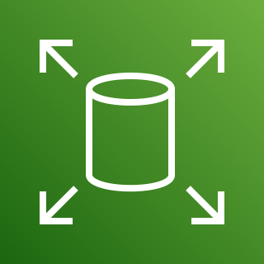





















Storage
1/6
Amazon Elastic Block Store (Amazon EBS)
Amazon Elastic File System (Amazon EFS)
AWS Storage
Gateway
Snapshot
Multiple volumes
File system
One Zone
Noncached
volume
Cached
volume
Amazon FSx
File Gateway
Volume
Volume gp3
One Zone Infrequent Access
Standard
Virtual tape
library
Tape
Gateway
Amazon S3
File Gateway
Amazon Data Lifecycle Manager
Standard–Infrequent Access
Intelligent-Tiering
Volume
Gateway
File
gateway

Slide 147





Storage
2/6
Amazon FSx
for Lustre
Amazon FSx for
Windows File Server
Amazon FSx
CloudEndure
Disaster Recovery
File system
File system

Slide 148

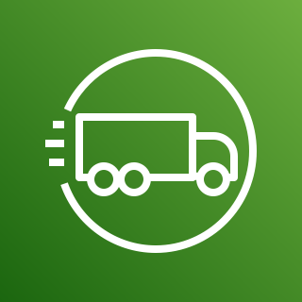



Storage
3/6
AWS Snowball Edge
AWS Snowmobile
AWS Snowball
AWS Snowcone
Snowball
import-export

Slide 149



















Storage
4/6
Amazon Simple Storage Service (Amazon S3)
S3 Standard
S3 Intelligent-
Tiering
S3 Standard-IA
S3 One
Zone-IA
S3 Glacier
Flexible Retrieval
S3 Glacier Deep Archive
S3 Glacier Instant Retrieval
S3 on Outposts
Bucket
Bucket with
objects
Replication
S3 Replication
Time Control
S3 Storage
Lens
Access points
VPC access points
Object
S3 Object Lambda
S3 Object Lambda access points

Slide 150






Storage
5/6
Amazon S3 on Outposts
Amazon Simple Storage Service Glacier
Amazon FSx for NetApp ONTAP
Amazon FSx for OpenZFS
Vault
Archive

Slide 151
















Storage
6/6
AWS Backup
Backup plan
Backup vault
Virtual machine
Virtual machine monitor
AWS Backup support for VMware workloads
Recovery point objective
Recovery time objective
Database
Storage
AWS Backup support for Amazon S3
Compliance reporting
Backup restore
Gateway
Compute
AWS Backup support for Amazon FSx for NetApp ONTAP

Slide 152

VR & AR
STANDARD
CATEGORY ICON

Slide 153

VR & AR
1/1
Amazon Sumerian

